Slide 1
ТЕХНОЛОГИИ HUAWEI
ДЛЯ ПОСТРОЕНИЯ КАТАСТРОФОУСТОЙЧИВЫХ РЕШЕНИЙ
ПО ХРАНЕНИЮ ДАННЫХ
СВИНАРЕНКО ВЛАДИМИР
МЕНЕДЖЕР ПО ИТ РЕШЕНИЯМ
ДЕПАРТАМЕНТ РЕШЕНИЙ ЦОД ООО «ТЕХКОМПАНИЯ ХУАВЭЙ»

Slide 2
Содержание
1
ЭТАПЫ РАЗВИТИЯ КАТАСТРОФОУСТОЙЧИВЫХ РЕШЕНИЙ HUAWEI ДЛЯ СХД
2
ОБЗОР ЛИНЕЙКИ СХД HUAWEI
3
ФУНКЦИОНАЛ HYPERMETRO
4
ВАРИАНТЫ РЕАЛИЗАЦИИ КАТАСТРОФОУСТОЙЧИВЫХ СЕРВИСОВ

Slide 3


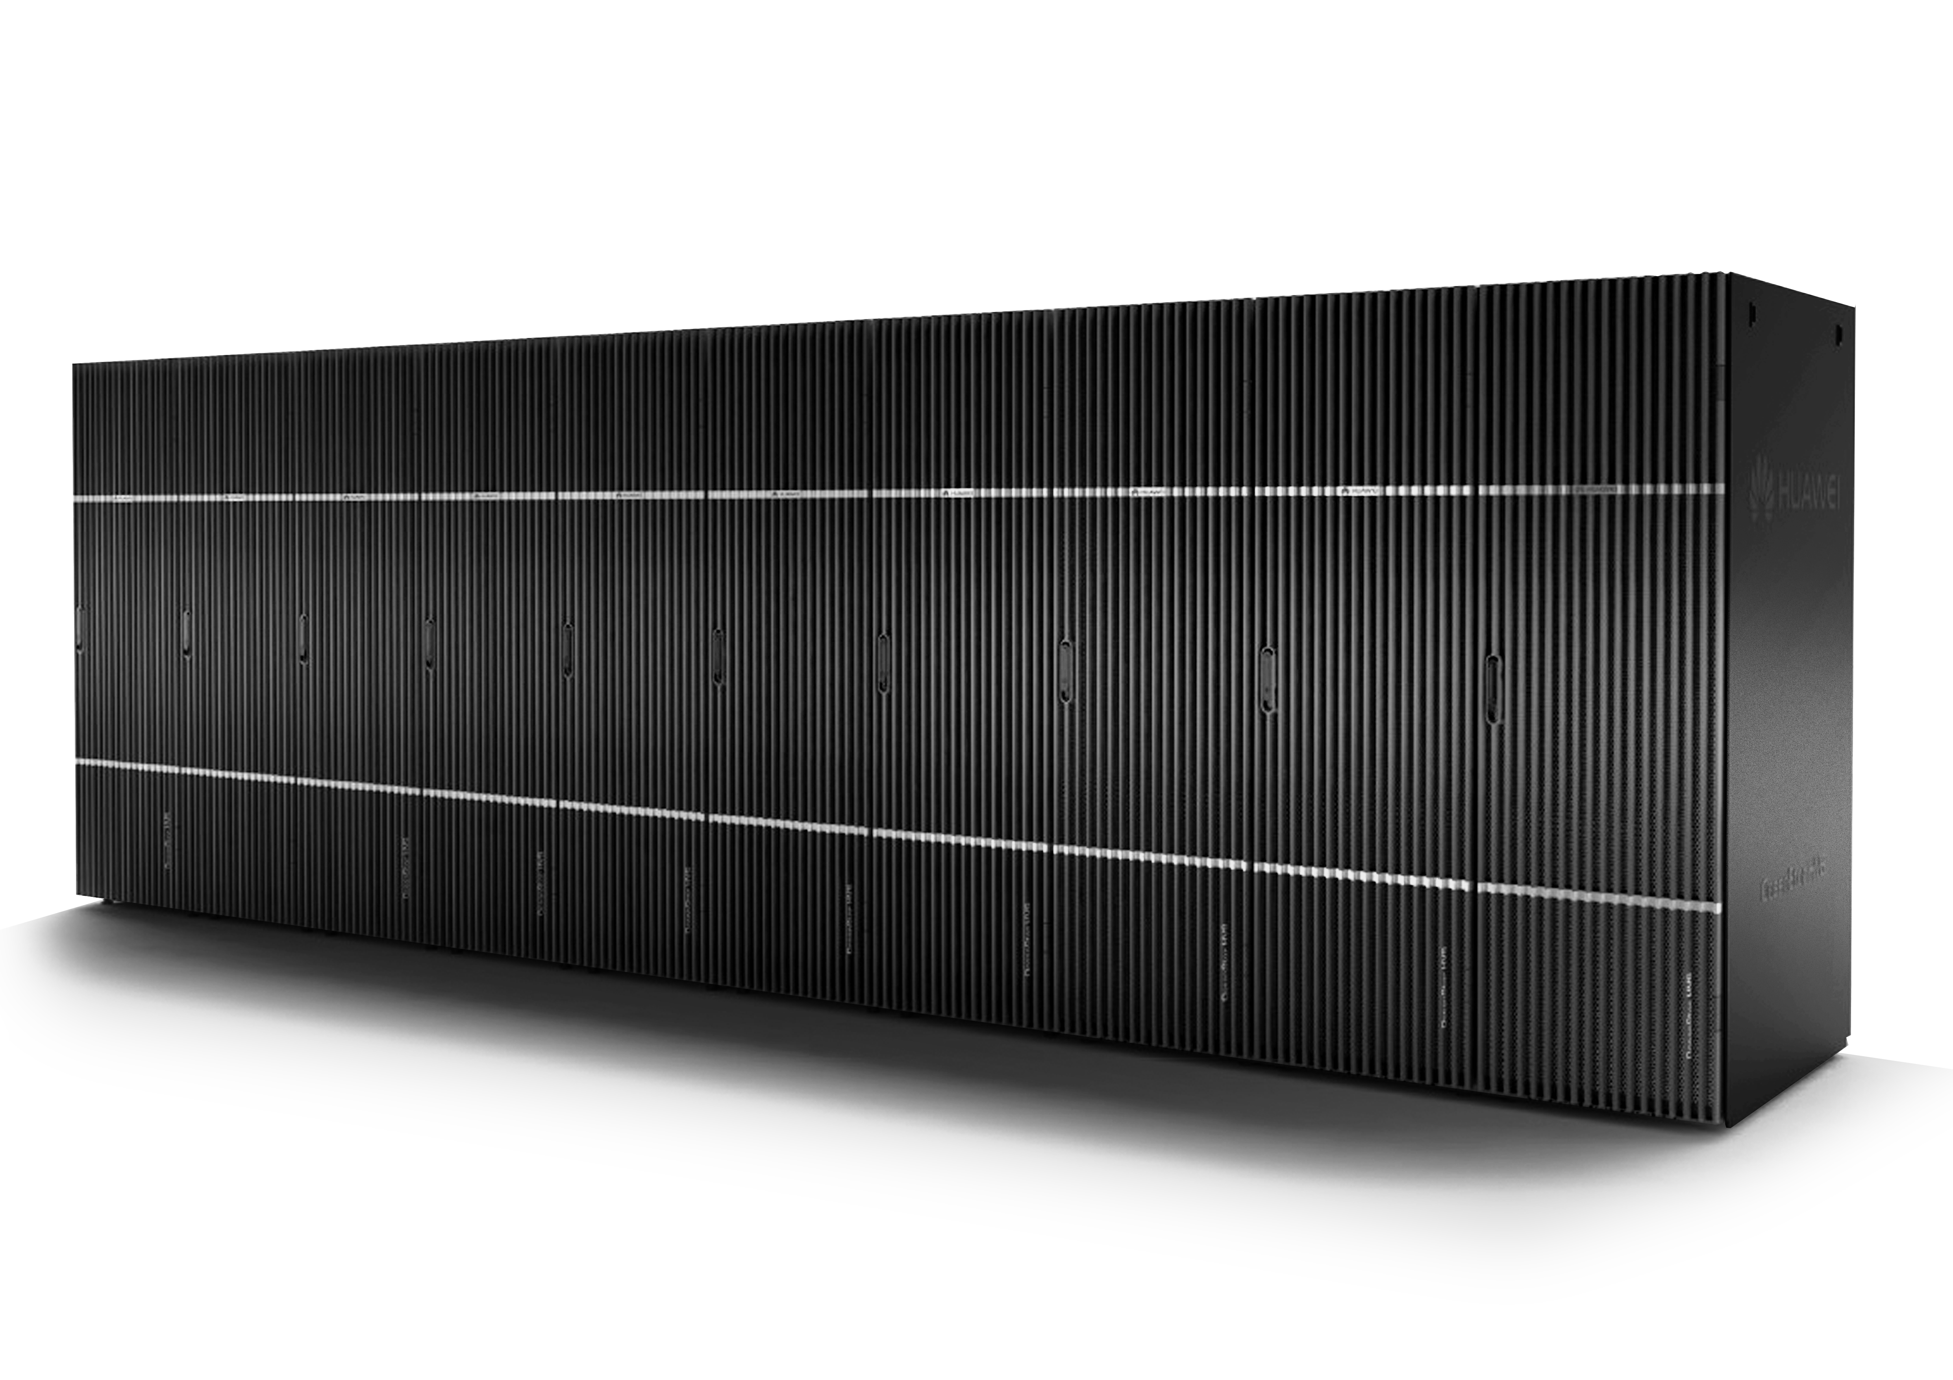


ЭТАПЫ РАЗВИТИЯ КАТАСТРОФОУСТОЙЧИВЫХ РЕШЕНИЙ HUAWEI ДЛЯ СХД
2002
2003
2004
2005
2006
2007
2008
2009
2010
2011
2012
2013
2014
2015
Телеком рынок
Инновации
Облачная эра
Start Server & Storage R&D
Converged Storage
Open Cloud
1st-gen blade server T8000
Cloud OS
Big Data Platform
First FC SAN F800 launched
Enterprise Storage
Big Data storage
Converged infrastructure
4Gb SAN product launched
Full series NAS/SAN/VIS Product
Huawei Acquires Symantec Stake in Huawei Symantec Joint Venture
New T series SAN & Full SSD SAN
Joint Venture from Huawei and Symantec
First SSD PCIe cards in the industry
High-density X servers for datacenters
Cloud Operation System FusionSphere
Start Cloud Computing R&D
RH1285 and RH2285 rack servers
E6000 blade servers, iNIC, and 2nd-generation SSD

Slide 4
Содержание
1
ЭТАПЫ РАЗВИТИЯ КАТАСТРОФОУСТОЙЧИВЫХ РЕШЕНИЙ HUAWEI ДЛЯ СХД
2
ОБЗОР ЛИНЕЙКИ СХД HUAWEI
3
ФУНКЦИОНАЛ HYPERMETRO
4
ВАРИАНТЫ РЕАЛИЗАЦИИ КАТАСТРОФОУСТОЙЧИВЫХ СЕРВИСОВ

Slide 5


ОБЗОР ЛИНЕЙКИ Конвергентных
СХД HUAWEI
5300 V3
5500 V3
5600 V3
5800 V3
6800 V3
Унифицированное ПО \ аппаратное обеспечение и управление
Отличные характеристики
Высокая надежность
Перспективная облачная архитектура

Slide 6
Характеристики систем
 |  | 5300 V3 | 5500 V3 | 5600 V3 | 5800 V3 | 6800 V3
Базовые характеристики | Максимальное кол-во дисков | 500 | 750 | 1000 | 1500 | 3200
 | Макс. Кол-ко контроллеров | 8 | 8 | 8 | 8 | 8
 | Кэш на контроллер | Standard: 16 GB Maximum: 32 GB | Basic: 24 GB Standard: 48 GB Maximum: 64 GB | Standard: 32 GB Maximum: 64 GB | Standard: 64 GB Maximum: 128 GB | Basic: 128 GB Standard: 256GB Maximum: 512GB
 | Макс. IO модулей на контроллер | 2 | 2 | 8 | 8 | 6
 | Протоколы | Fibre Channel, FCoE, iSCSI, InfiniBand, NFS, CIFS, HTTP, and FTP
Функционал | Эффекивность | SmartThin, SmartQoS, SmartMotion, SmartPartition, SmartCache, SmartCompression, SmartDedupe, SmartTier, SmartMulti-Tenant, SmartVirtualization, SmartMigration, SmartErase, SmartQuota,
 | Защита данных | HyperSnap, HyperReplication, HyperClone, HyperCopy, HyperMetro, HyperLock, HyperVault
 | ПО для хостов | UltraPath and ReplicationDirector
 | ПО управления | DeviceManager, ReplicationDirector, and eSight
Виртуализация | Поддержка (VMs) | VMware, Citrix, Hyper-V, and FusionSphere

Slide 7
Содержание
1
ЭТАПЫ РАЗВИТИЯ КАТАСТРОФОУСТОЙЧИВЫХ РЕШЕНИЙ HUAWEI ДЛЯ СХД
2
ОБЗОР ЛИНЕЙКИ СХД HUAWEI
3
ФУНКЦИОНАЛ HYPERMETRO
4
ВАРИАНТЫ РЕАЛИЗАЦИИ КАТАСТРОФОУСТОЙЧИВЫХ СЕРВИСОВ

Slide 8

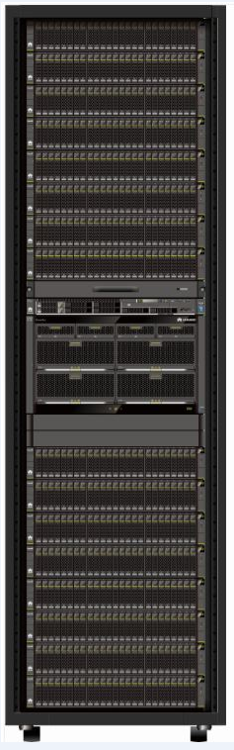

HyperMetro (array active-active solution)
Принцип работы
DC A
DC B
  LUNs in the 2 storage arrays in DCs A and B form a HyperMetro pair. The LUNs are represented with the same LUN WWN on and recognized as the same LUN by hosts. In this way, synchronous data mirroring is performed by the storage arrays, mutual access exclusion is achieved, and active-active arbitration is implemented.
Oracle RAC/VMware vSphere
/FusionSphere cluster
…
Преимущества
WAN
  RPO=0, RTO=0
  Requires no gateway devices, simplifying networks, saving costs, and eliminating gateway-caused latency.
  Supports storage protocol optimization, reducing cross-site interactions of a write I/O by half.
  Supports automatic cross-DC bad block repair.
  Supports flexible combination of high-end, mid-range, and entry-level storage arrays for active-active solutions, saving investment.
  Supports read and write cache, improving performance.
  Supports smooth upgrade from active-active or active-standby solutions to 3DC solutions without service interruption.
  Flexibly supports 10GE or FC networks for intra-city interconnection and IP networks for arbitration links.
  UltraPath supports preferred selection of local paths to deliver I/Os.
FC/IP SAN
SAN
FC/IP SAN
Production
storage
Synchronous mirroring
Production
storage
IP
network
IP
network
Arbitration device

Slide 9
HyperMetro (active-active solutions) — active-active arbitration
  Arbitration deployment
Режим работы - Арбитр
  Arbitration devices are deployed in 3rd-party sites and in different fault domains from the DCs.
  When faults such as split-brain occur, the storage arrays apply for arbitration. The winning array continues services while the losing one stops services. Preferred arrays enjoy arbitration preference.
  UltraPath supports preferred selection of local paths.
  If arbitration devices malfunction, the mode switches to the static priority mode after a certain period of time.
Storage resource pool
Quorum disk 1
Storage array A
Storage array B
Режим работы - Приоритет
Arbitration device
  Requires no arbitration servers.
  For each active-active pair, you can set the storage array at either end as the preferred site and that on the other end as the non-preferred site.
  When a split-brain occurs or the non-preferred site malfunctions, LUNs in the preferred site continue services while those in the non-preferred site stop services.
  However, if the preferred site becomes faulty, the non-preferred site will not take over services and services will then stop.
  Arbitration device: a physical or virtual server
  Arbitration link: any link reachable by IP addresses
  Mechanism: The array winning the arbitration server survives.

Slide 10
HyperMetro (array active-active solution) — active-active arbitration
No. | Диаграмма | Результат
1 |  | Fault: arbitration failure Arbitration result: Both H1 and H2 continues running.
2 |  | Fault: link fault between H1/H2 and the arbitration device Arbitration result: Both H1 and H2 continues running.
3 |  | Fault: H1/H2 failure Arbitration result: H1/H2 stops running while H2/H1 continues running.
4 |  | Fault: inter-array link interruption Arbitration result: H2 stops running while H1 (the preferred array) continues running.
5 |  | Fault: interruption of links between H1 and H2 and between H1 and the arbitration device Arbitration result: H1 stops running while H2 continues running.
C
H1
H2
C
H1
H2
C
H1
H2
C
H1
H2
C
H1
H2

Slide 11
Содержание
1
ЭТАПЫ РАЗВИТИЯ КАТАСТРОФОУСТОЙЧИВЫХ РЕШЕНИЙ HUAWEI ДЛЯ СХД
2
ОБЗОР ЛИНЕЙКИ СХД HUAWEI
3
ФУНКЦИОНАЛ HYPERMETRO
4
ВАРИАНТЫ РЕАЛИЗАЦИИ КАТАСТРОФОУСТОЙЧИВЫХ СЕРВИСОВ

Slide 12
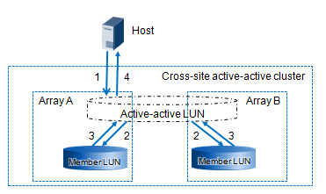
Cross-Data-Center Active-Active VMware Cluster Solution
HyperMetro Working Principles
vMSC Test
vMSC
vSphere Metro Storage Cluster (vMSC) enables a vSphere platform to implement HA and Distributed Resource Scheduler (DRS) functions across two physical sites. However, it requires the storage to support cross-site real-time data replication to ensure data reliability and service continuity.
vMSC | Result
Cross-DC VM migration | No impact on services
Physical server breakdown | Services are interrupted for 105s.
Single-link failure of physical server | No impact on services
Storage failure in DC A | No impact on services
All-link failure of storage in DC A | No impact on services
All-link failure of all hosts in DC A | Services are interrupted for 120s.
Failure of storage replication links | No impact on services
Failure of storage management network | No impact on services
All-link failure between DCs | Services are interrupted for 154s.
Failure of DC A | Services are interrupted for 108s.
Failure of DC B | Services are interrupted for 150s.
Performance Test
Under a proper workload, the inter-DC distance is increased by DWDM to test the performance. According to the test, transactions per second (TPS) fluctuates slightly and latency increases linearly as the inter-DC distance grows. In conclusion, the distance has little impact on the system performance.
Cross-DC mirroring
About VMware HA
The High Availability (HA) feature keeps monitoring all ESXi servers in the cluster to detect faults. HA agents placed on hosts send heartbeat signals to peer hosts in the cluster at regular intervals. Interruption of heartbeats causes affected VMs to restart on other functioning hosts, thereby ensuring service continuity.
The solution has been tested using simulated scenarios. For ERP application, SwingBench Order Entry 2.0 workload model has been simulated on Oracle Database 12c. For CRM application, TPC-E workload model has been simulated on SQL Server 2012. Order Entry and TPC-E are widely used OLTP workload models. They simulate massive online user transactions mainly consisting of random small-block access.

Slide 13
Implementing a Cross-Data-Center Active-Active Oracle RAC Solution
Huawei Disaster Recovery Data Center Solution (Active-Active Mode)
Huawei Disaster Recovery Data Center Solution (Active-Active Mode) employs a six-layer active-active reliability design and load balancing to ensure zero service interruption and zero data loss, delivering the highest-level protection of service continuity in the industry.
Adopting a gateway-free active-active architecture, Huawei Disaster Recovery Data Center Solution (Active-Active Mode) allows data to be concurrently read from and written to both data centers and minimizes the number of failure points to offer higher system reliability. Active-active I/O optimization and the gateway-free active-active architecture minimize the I/O processing path. Furthermore, link optimization, storage protocol optimization, and site access optimization significantly improve active-active service performance.
In Oracle database scenarios, you can configure the SmartTier and FastWrite features for the active-active solution and properly set UltraPath parameters on service hosts in data centers according to the verification results in this document, thereby optimizing performance.

Slide 14
Implementing a Cross-Data-Center Active-Active Oracle RAC Solution
Site Access Optimization
The priority mode is mainly used in scenarios where the active-active
service is deployed across two data centers that are far away from
each other. In such scenarios,
access across active-active data
centers is costly. If the link
distance between the data
centers is 100 km, a round-trip
transmission typically takes
approximately 1.3 ms. The priority
mode reduces interactions across
data centers, helping improve the I/O performance.
Improving Database Performance Based on Site Access Optimization
From the perspective of database administrators, properly configuring the priority mode can improve the transaction throughput of Oracle Database by 5% to 18%.
Improving Database Performance Based on FastWrite
From the perspective of database administrators, enabling FastWrite can improve the transaction throughput of Oracle Database by 7% to 29%.
FastWrite Link Optimization
HyperMetro employs the FastWrite function to make protocol-level optimizations to data transmission between storage arrays. With the First Burst Enabled function of the SCSI protocol, the number of interactions involved in transmitting a write I/O over a link is reduced by 50%.
The OLTP workload is simulated by using the workload model of EbankModel on Oracle Database 11g. This workload model is a widely used OLTP workload model. It simulates massive online user transactions mainly consisting of random small-block access, with a read/write ratio at 6:4.

Slide 15
Спасибо за внимание
www.huawei.com
Copyright © Huawei Technologies Co., Ltd. 2015. All rights reserved.
All logos and images displayed in this document are the sole property of their respective copyright holders. No endorsement, partnership, or affiliation is suggested or implied. The information in this document may contain predictive statements including, without limitation, statements regarding the future financial and operating results, future product portfolio, new technology, etc. There are a number of factors that could cause actual results and developments to differ materially from those expressed or implied in the predictive statements. Therefore, such information is provided for reference purpose only and constitutes neither an offer nor an acceptance. Huawei may change the information at any time without notice.

